Slide 1
Risen One Consulting Project Option 2
By The Team™
Nikolos Antonio, Alexis King, Max McGinn, Ashlea Shaffer, Lily Weiss

Slide 2

Who we Are?
Nikolos Antonio
Computer Science - Computer Science
Max McGinn
Computer Science - Software Development
Lily Weiss
Computer Science - Software Engineering
Alexis King
Computer Science - Software Development
Ashlea Shaffer
Computer Science - Software Development
Cybersecurity

Slide 3
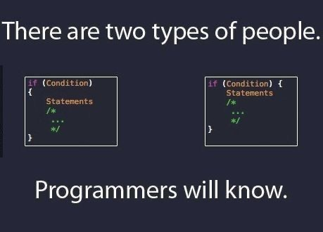

Slide 4
Our Challenges
Learning to use Angular
Learning how to use Github
Learning how to use AWS

Slide 5
What did we learn?
How to work in a group setting
How to use Github
Angular Material
JIRA
AWS
Troubleshooting
Never say something looks easy

Slide 6
Live Project Demo

Slide 7
Our Stretch Goals
Complete the login page to differentiate between employees and managers
Pull from AWS upon login and fill in the correct text boxes
Improve the design of the front-end

Slide 8
Thank you!

